Slide 1
Mintendo Swich
組員:廖耕毅 門玉仁 陳妍喻

Slide 2
Outline
Motivation
Introduction
Project structure
Demo clips
Improvements
Low energy consideration(ISR, sleeping mode)
wifi session handling
Enhancing motion detection accuracy
Conclusion
Future works

Slide 3
Motivation
Computer games are usually based on keyboard manipulation, if we can play computer games based on motion, the gaming experience can be better.
Promote exercising while gaming, instead of just pressing key board

Slide 4
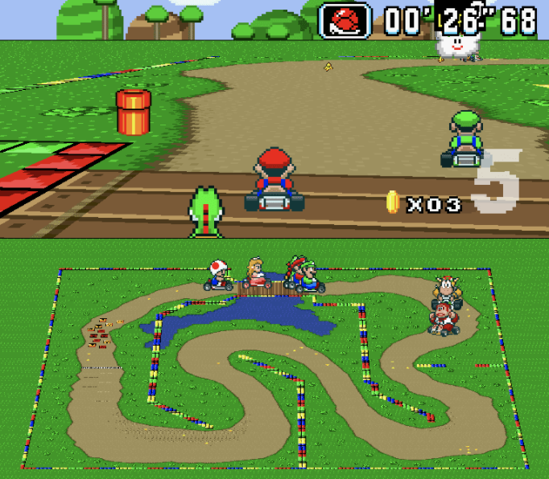

Introduction
We intended to design stm32 as a video game controller which can easily adapt on different video games with sensitive controlling, low energy consideration and some user friendly designs.
Specifically, we will demonstrate our project on Mario kart game and pong.

Slide 5
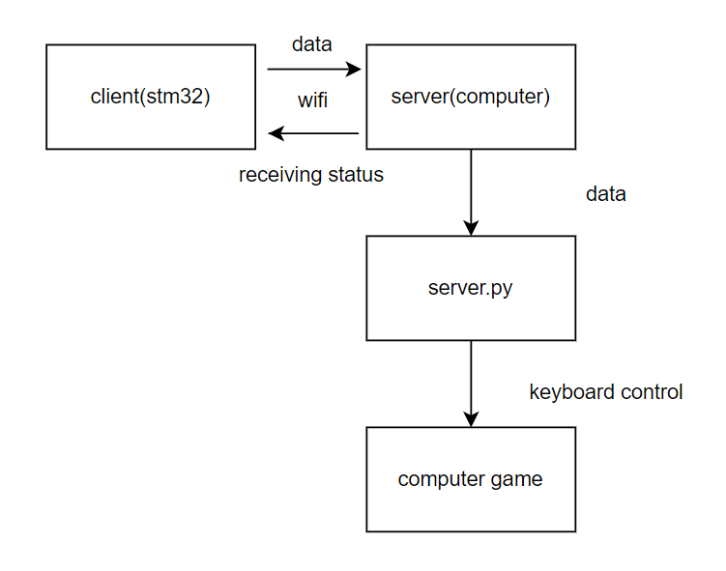
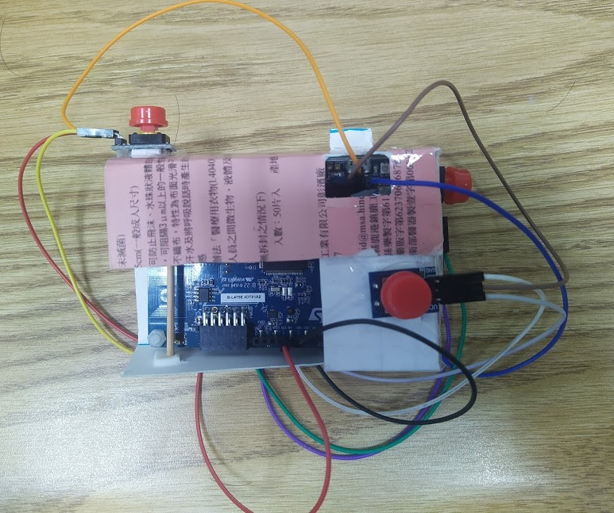
Project Structure and Controller Design

Slide 6
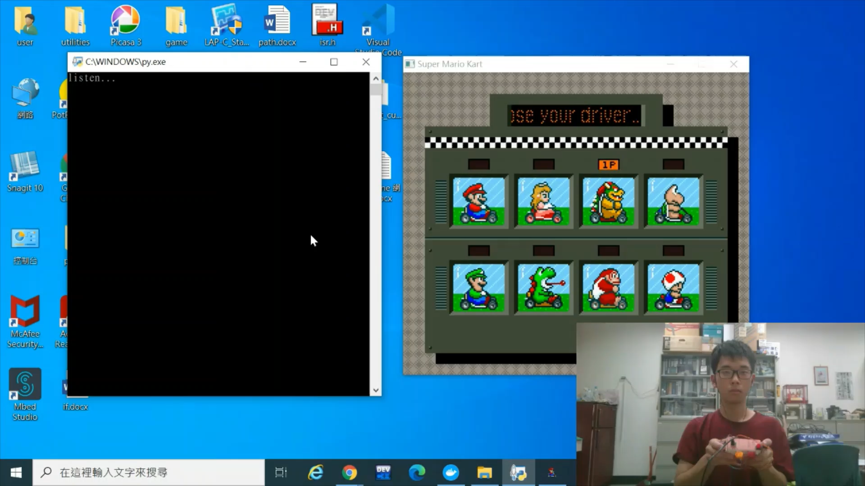
Demo Clips – Mario Kart

Slide 7
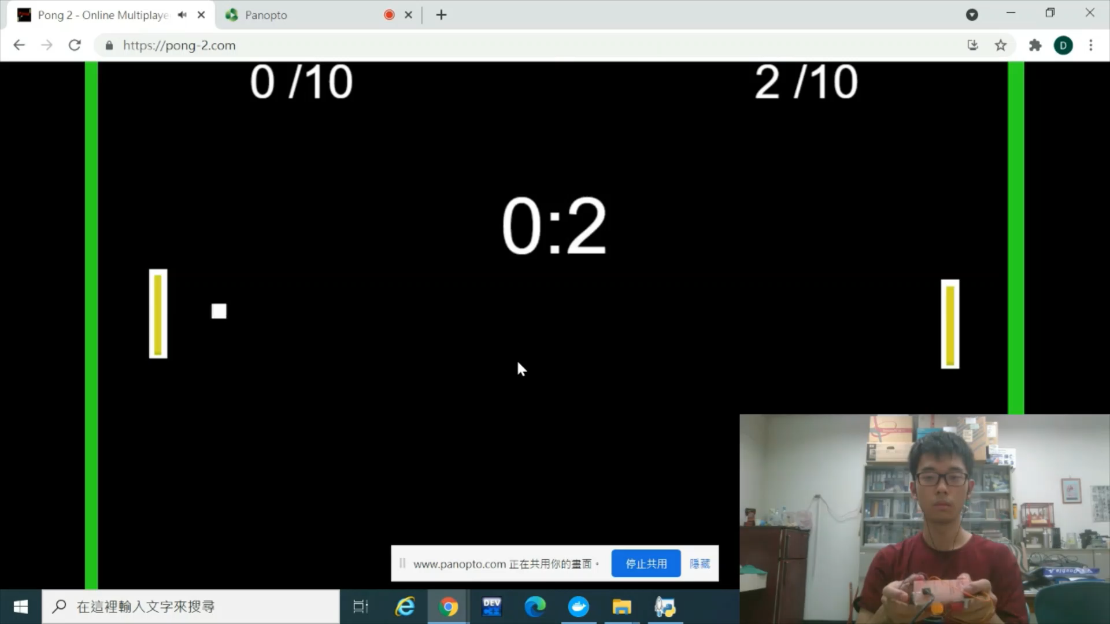
Demo Clips – Pong

Slide 8
Improvements-Low Energy Design(ISR)
Purpose: pressing button triggers ISR to send data to server
Problem 1:
Description: Bouncing -> trigger ISR multiple times with incorrect reading value
Solution: Disable IRQ -> program order is important
Problem 2:
Description: Multiple interruptins -> cause program malfunction
Maybe sharing same interrupt vector -> unsolved

Slide 9
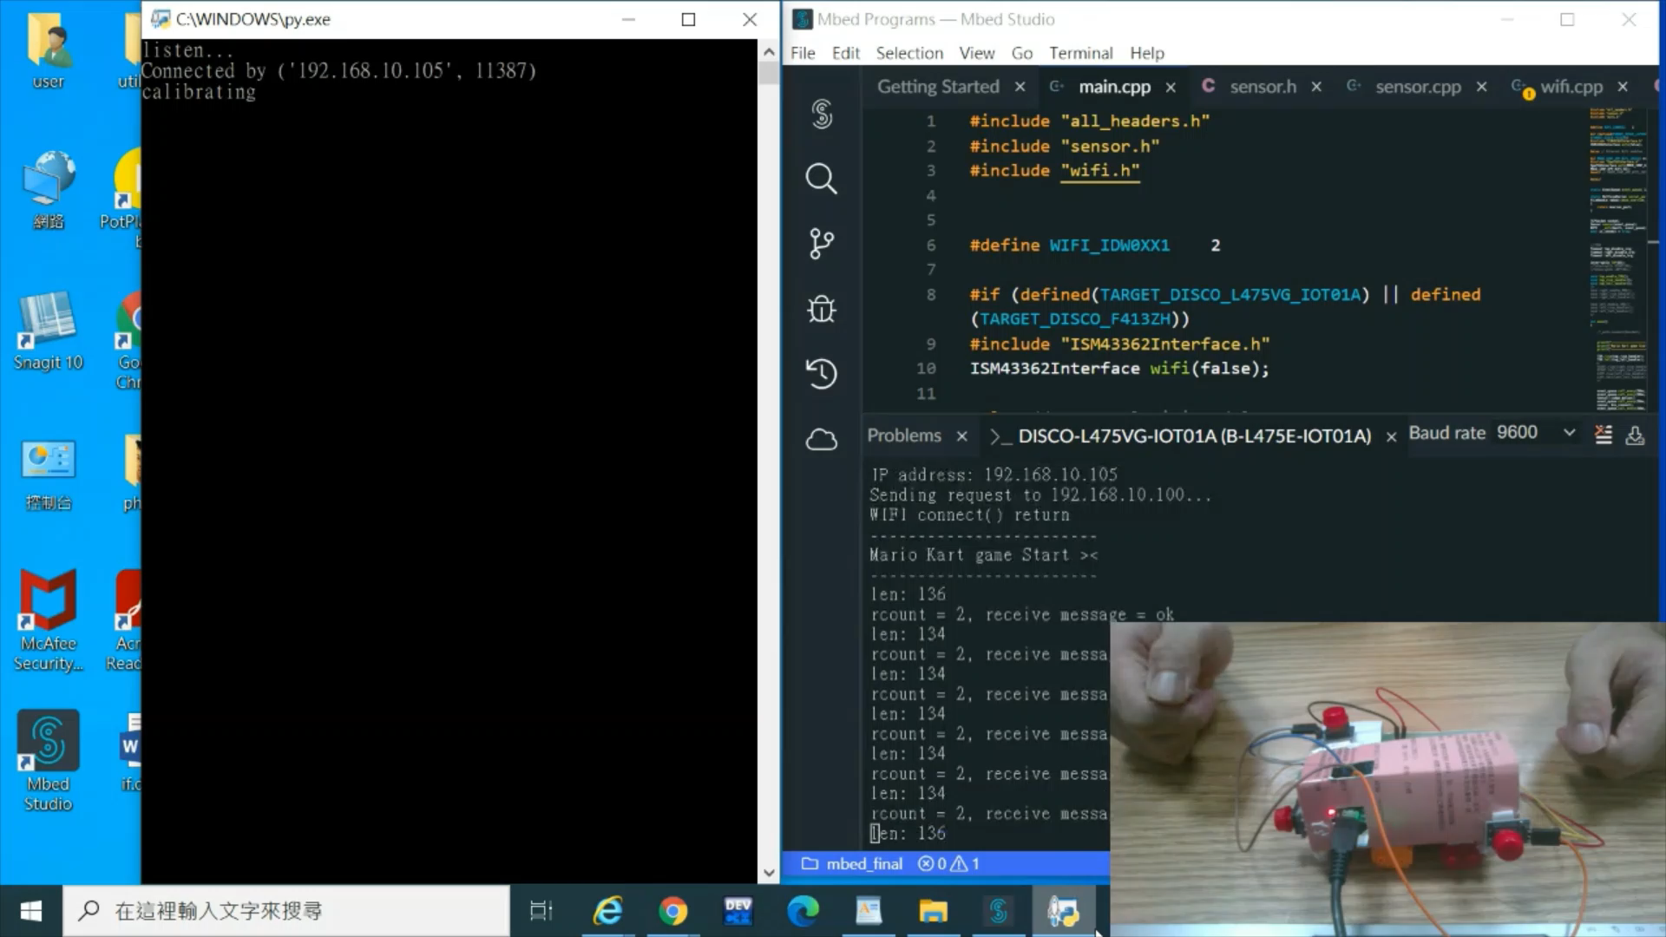
Improvements-Low Energy Design(Sleeping Mode)
Purpose: If no motion occurs, stm32 will enter sleeping mode(e.g. not sending data to server) to save energy.
With high sensitivity, we will not miss any motion

Slide 10
WIFI Session Handling
Purpose: handling sever client disconnection issues
Improvement 1:
Description: stm32 lose wifi connection
Solution: Prompt error and looping for re-connection
Improvement 2:
Description: Can not establish server-client connection
Solution: Prompt error and restart a new socket
Improvement 3:
While gaming, if socket disconnect unexpectedly, the program will exit and prompt error for restarting the system

Slide 11
Enhancing Motion Detection Accuracy
Problem: After stm32 sensor’s calibration, bias still remains.
Description: Bias are random offsets, which limits detection accuracy
Solution: Calibrate once more on server
Benefits: This greatly enhance our detection accuracy
Future work: during gaming your hand’s position will change slightly which will again affect detection accuracy -> dynamic calibration

Slide 12
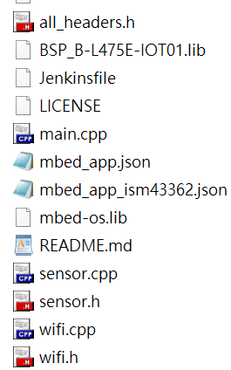
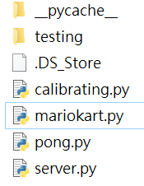
Conclusion - Project
Video game controller features:
Key board manipulation:
Easily adapt on different games
Avoid game looping asynchronous problem
Low energy consideration
ISR
Sleeping mode
Wifi reconnection designs
Precise motion detection
Manageable OOP design
server
client

Slide 13
Conclusion – Used Course Materials
Input devices
Interrupt Service Routine
bouncing handling
Event and eventqueue
Sensor node
Wifi and client socket server

Slide 14
Future Works
Multiple Interruptins implementation
Dynamic calibration

Slide 15
Reference
https://github.com/vmbatlle/super-mario-kart
https://github.com/boppreh/keyboard
https://os.mbed.com/docs/mbed-os
https://os.mbed.com/teams/ST/code/DISCO_L475VG_IOT01-Sensors-BSP/
http://os.mbed.com/teams/ST/code/mbed-os-example-wifi/
Mario kart https://youtu.be/GiSYW9s1_YA
Pong demo https://youtu.be/FAamO4nEKC8

Slide 16
Thank You For Your Attention

